Slide 1
Large Traffic Data Compression
Aman Sunesh, Seoyoon Jung, Damiane Kapanadze

Slide 2
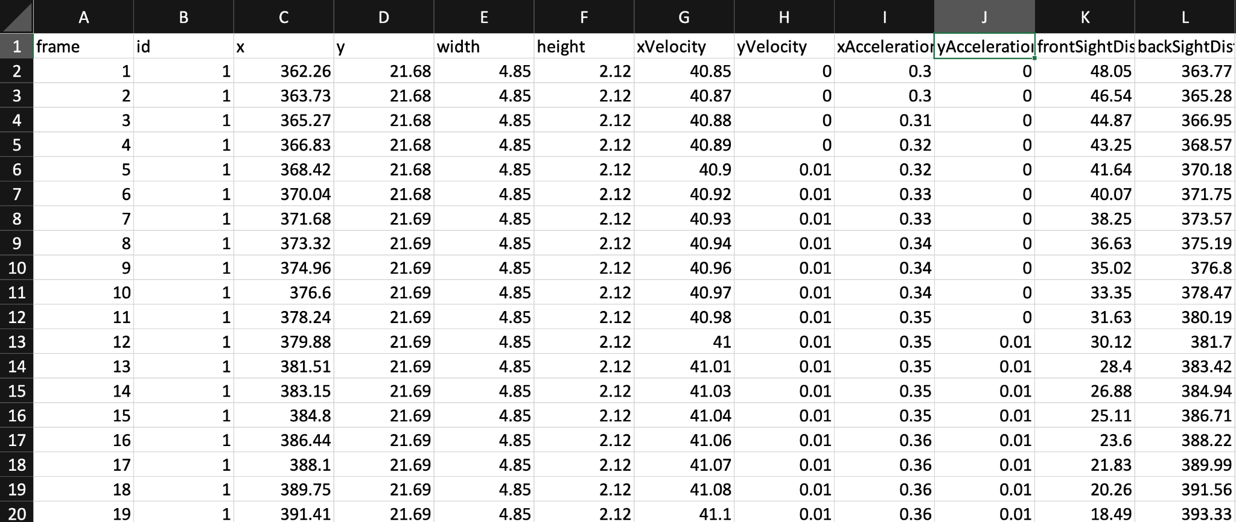
The Dataset:
Aman Sunesh, Seoyoon Jung, Damiane Kapanadze
Introduction to Data Analysis | Fall 2024 | Large Traffic Data Compression

Slide 3
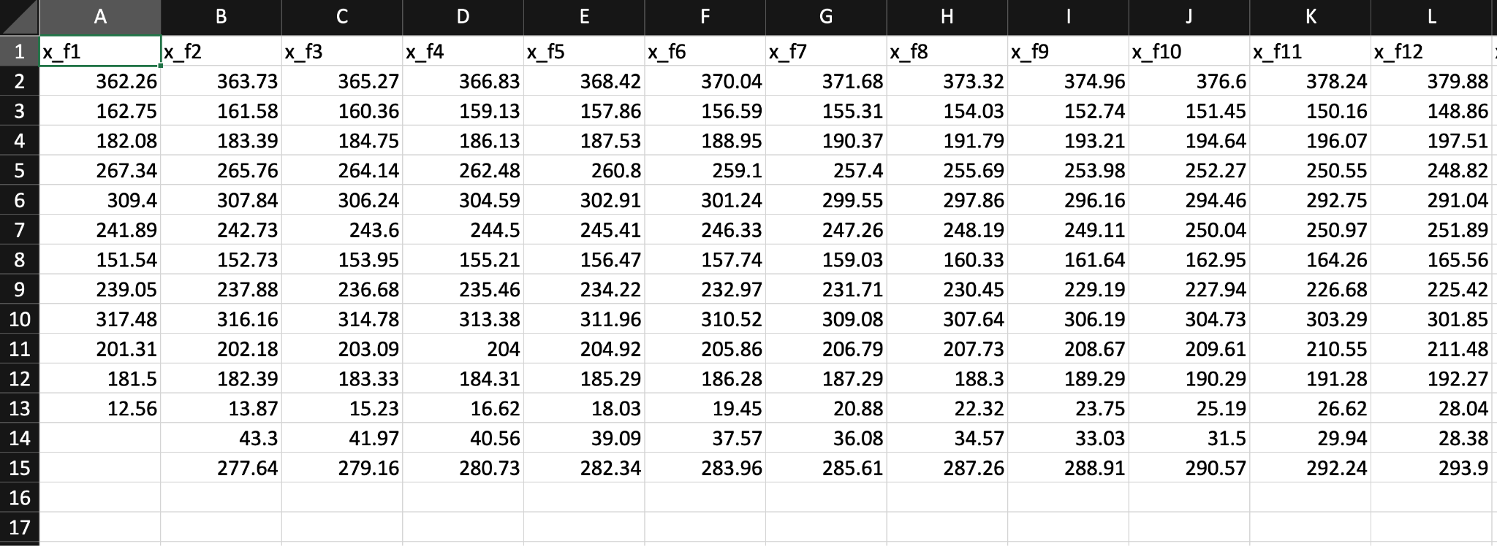
The Dataset:
Aman Sunesh, Seoyoon Jung, Damiane Kapanadze
Introduction to Data Analysis | Fall 2024 | Large Traffic Data Compression

Slide 4
Approach - 1 - Random Sampling
15.86
x_f1 | x_f2 | x_f3 | x_f4 | x_f5 | x_f6 | x_f7 | x_f8
362.26 | 363.73 | 365.27 | 366.83 | 368.42 | 370.04 | 371.68 | 373.32
162.75 | 161.58 | 160.36 | 159.13 | 157.86 | 156.59 | 155.31 | 154.03
182.08 | 183.39 | 184.75 | 186.13 | 187.53 | 188.95 | 190.37 | 191.79
267.34 | 265.76 | 264.14 | 262.48 | 260.80 | 260.80 | 257.40 | 255.69
NaN | NaN | NaN | NaN | NaN | 28.04 | 203.24 | 15.86
NaN | NaN | NaN | NaN | 22.32 | 36.65 | 42.41 | 15.86
NaN | NaN | 43.3 | 39.09 | 36.08 | 17.42 | 15.86 | 9.65
Aman Sunesh, Seoyoon Jung, Damiane Kapanadze
Introduction to Data Analysis | Fall 2024 | Large Traffic Data Compression
Notes:
Random sampling involves selecting data points randomly without considering their specific characteristics or importance. Each data entry in the matrix has an equal probability of being selected.

Slide 5
Approach - 1 - Random Sampling
15.86
x_f1 | x_f2 | x_f3 | x_f4 | x_f5 | x_f6 | x_f7 | x_f8
362.26 | 363.73 | 365.27 | 366.83 | 368.42 | 370.04 | 371.68 | 373.32
162.75 | 161.58 | 160.36 | 159.13 | 157.86 | 156.59 | 155.31 | 154.03
182.08 | 183.39 | 184.75 | 186.13 | 187.53 | 188.95 | 190.37 | 191.79
267.34 | 265.76 | 264.14 | 262.48 | 260.80 | 260.80 | 257.40 | 255.69
NaN | NaN | NaN | NaN | NaN | 28.04 | 203.24 | 15.86
NaN | NaN | NaN | NaN | 22.32 | 36.65 | 32.41 | 15.86
NaN | NaN | 43.3 | 39.09 | 36.08 | 17.42 | 15.86 | 9.65
Aman Sunesh, Seoyoon Jung, Damiane Kapanadze
Introduction to Data Analysis | Fall 2024 | Large Traffic Data Compression
Notes:
Although the data can be made compressed to an extent using this method, This method does not account for the variability or importance of the data features. All features are treated equally, potentially ignoring critical variations. Vital information might be lost if important but less frequent features are not sampled effectively.

Slide 6
Approach - 1 - Random Sampling
15.86
x_f1 | x_f2 | x_f3 | x_f4 | x_f5 | x_f6 | x_f7 | x_f8
362.26 |  |  |  |  |  | 371.68
 |  | 160.36 |  |  |  |  | 154.03
182.08 |  |  |  |  |  |  | 191.79
 |  |  | 262.48 |  | 260.80
NaN | NaN | NaN | NaN | NaN
NaN | NaN | NaN | NaN
NaN | NaN
Aman Sunesh, Seoyoon Jung, Damiane Kapanadze
Introduction to Data Analysis | Fall 2024 | Large Traffic Data Compression
Notes:
Although the data can be made compressed to an extent using this method, This method does not account for the variability or importance of the data features. All features are treated equally, potentially ignoring critical variations. Vital information might be lost if important but less frequent features are not sampled effectively. Another method is column sampling which has the same issues

Slide 7
Approach - 2 - Importance Sampling
X_True
Calculate the variability (range = max - min) for each feature in the dataset. Range is chosen because it indicates the spread of data.
Higher variability often indicates more informative or significant data.
Convert these importance measures into probabilities and then we normalized them, ensuring that the sum of all probabilities is equal to 1.
 | x-f1 | x-f2 | x-f3
ID1 | 100 | 200 | NaN
ID2 | 290 | 210 | 300
ID3 | 120 | 190 | 310
ID4 | 130 | NaN | 320
ID5 | 140 | 205 | NaN
Aman Sunesh, Seoyoon Jung, Damiane Kapanadze
Introduction to Data Analysis | Fall 2024 | Large Traffic Data Compression
Notes:
Importance sampling is a statistical technique used in data processing to selectively retain a subset of data based on its significance or "importance". It helps in focusing on the most informative parts of the data, which is crucial when dealing with large datasets. This technique helps reduce complexity without loosing critical information.
The range (difference between the maximum and minimum values) is calculated for each feature because it indicates the spread of the data. Features with a wider range tend to have more variability, which often means they contain more information and are potentially more influential in analysis.

Slide 8
Calculating Range
 | x-f1 | x-f2 | x-f3
ID1 | 100 | 200 | NaN
ID2 | 290 | 210 | 300
ID3 | 120 | 190 | 310
ID4 | 130 | nAn | 320
ID5 | 140 | 205 | NaN
Feature1: Range = Max(140) - Min(100) = 40
Feature2: Range = Max(210) - Min(190) = 20
Feature3: Range = Max(320) - Min(300) = 20
Aman Sunesh, Seoyoon Jung, Damiane Kapanadze
Introduction to Data Analysis | Fall 2024 | Large Traffic Data Compression

Slide 9
Normalize it to Create a Probability Distribution
 | x-f1 | x-f2 | x-f3
ID1 | 100 | 200 | NaN
ID2 | 290 | 210 | 300
ID3 | 120 | 190 | 310
ID4 | 130 | nAn | 320
ID5 | 140 | 205 | NaN
Total Importance = 40 (Feature1) + 20 (Feature2) + 20 (Feature3) = 80
Probabilities:
Feature1: 40/80 = 0.5
Feature2: 20/80 = 0.25
Feature3: 20/80 = 0.25
Aman Sunesh, Seoyoon Jung, Damiane Kapanadze
Introduction to Data Analysis | Fall 2024 | Large Traffic Data Compression

Slide 10
Probability Distribution Matrix
 | x-f1 | x-f2 | x-f3
ID1 | 0.5 | 0.25 | 0.25
ID2 | 0.5 | 0.25 | 0.25
ID3 | 0.5 | 0.25 | 0.25
ID4 | 0.5 | 0.25 | 0.25
ID5 | 0.5 | 0.25 | 0.25
Aman Sunesh, Seoyoon Jung, Damiane Kapanadze
Introduction to Data Analysis | Fall 2024 | Large Traffic Data Compression
Notes:
This matrix does not replace the original data; it is used to decide the likelihood of each feature's values being retained in the sampling step. Features (or entries) that show greater variability are deemed more important, and hence have a higher probability value. The goal of assigning higher probabilities to more important data points is to ensure they are more likely to be included in the sampled dataset.

Slide 11
Time to Compress!
We generate a matrix of same dimension with random values for each cell from 0 to 1
 | x-f1 | x-f2 | x-f3
ID1 | 0.3 | 0.5 | NaN
ID2 | NaN | 0.1 | 0.5
ID3 | 0.6 | 0.3 | 0.1
ID4 | 0.2 | NaN | 0.4
ID5 | 0.7 | 0.1 | NaN
Aman Sunesh, Seoyoon Jung, Damiane Kapanadze
Introduction to Data Analysis | Fall 2024 | Large Traffic Data Compression
Notes:
In the sampling step , we generate random values for each cell and compare those to these probabilities to determine which values to retain. So if we choose our retain fraction to be high, all these probability values would be lower, ensuring that lesser data points are selected.

Slide 12
Compare with Probability Distribution Matrix
If the random value is less than the probability (from the Probability Distribution Matrix), the data point is retained (1).
If the random value is greater than or equal to the probability, the data point is not retained (0).
 | x-f1 | x-f2 | x-f3
ID1 | 0.7 | 0.1 | 0.2
ID2 | 0.7 | 0.1 | 0.2
ID3 | 0.7 | 0.1 | 0.2
ID4 | 0.7 | 0.1 | 0.2
ID5 | 0.7 | 0.1 | 0.2
 | x-f1 | x-f2 | x-f3
ID1 | 1 | 0 | NaN
ID2 | NaN | 0 | 0
ID3 | 1 | 0 | 1
ID4 | 1 | NaN | 0
ID5 | 1 | 0 | NaN
 | x-f1 | x-f2 | x-f3
ID1 | 0.3 | 0.5 | NaN
ID2 | NaN | 0.1 | 0.5
ID3 | 0.6 | 0.3 | 0.1
ID4 | 0.2 | NaN | 0.4
ID5 | 0.5 | 0.1 | NaN
Omega Matrix
Aman Sunesh, Seoyoon Jung, Damiane Kapanadze
Introduction to Data Analysis | Fall 2024 | Large Traffic Data Compression
Notes:
If the probability threshold is high (say 0.8), it means this feature is very important, and thus, it's fairly easy for a random value (uniformly distributed from 0 to 1) to be less than 0.8. This results in a high chance of retaining this important data point.
If the probability threshold is low (say 0.2), the feature is not as important, and it's harder for a random value to be less than 0.2. Thus, most random values will exceed this threshold, and the data point will more likely be excluded.

Slide 13
Finding Compressed Matrix R
R = Omega * X_true
 | x-f1 | x-f2 | x-f3
ID1 | 1 | 0 | NaN
ID2 | NaN | 1 | 0
ID3 | 0 | 0 | 1
ID4 | 1 | NaN | 0
ID5 | 0 | 1 | NaN
 | x-f1 | x-f2 | x-f3
ID1 | 100 | 200 | NaN
ID2 | 290 | 210 | 300
ID3 | 120 | 190 | 310
ID4 | 130 | NaN | 320
ID5 | 140 | 205 | NaN
 | x-f1 | x-f2 | x-f3
ID1 | 100 | 0 | NaN
ID2 | NaN | 210 | 0
ID3 | 0 | 0 | 310
ID4 | 120 | NaN | 0
ID5 | 0 | 205 | NaN
=
Omega
X_True
R
Aman Sunesh, Seoyoon Jung, Damiane Kapanadze
Introduction to Data Analysis | Fall 2024 | Large Traffic Data Compression
Notes:
Omega is a binary matrix that acts as an indicator or a mask. This is saved because it records the location of data points that have been considered significant enough to keep during the sampling process.
By converting many values to zero, the R matrix becomes sparse.
Save Omega and R.

Slide 14
Sparse Matrices
 | x-f1 | x-f2 | x-f3
ID1 | 1 | 0 | NaN
ID2 | NaN | 1 | 0
ID3 | 0 | 0 | 1
ID4 | 1 | NaN | 0
ID5 | 0 | 1 | NaN
 | x-f1 | x-f2 | x-f3
ID1 | 100 | 0 | NaN
ID2 | NaN | 210 | 0
ID3 | 0 | 0 | 310
ID4 | 120 | NaN | 0
ID5 | 0 | 205 | NaN
Omega
R
For R:
Data Array: [100, 210, 310, 130, 205] // Only non-zero values are stored
Indices Array: [0, 1, 2, 0, 1] // Corresponding column indices for non-zero values
Indptr Array: [0, 1, 2, 3, 4, 5] // Start index in the data array for each row
For Omega:
Data Array for Omega: [1, 1, 1, 1, 1] // Only non-zero values are stored (all ones because Omega only contains 0 or 1).
Indices Array for Omega: [0, 1, 2, 0, 1] // Corresponding column indices for the ones in Omega.
Indptr Array for Omega: [0, 1, 2, 3, 4, 5] // Start index in the data array for each row, identical to R because both matrices have the same sparsity pattern.
Aman Sunesh, Seoyoon Jung, Damiane Kapanadze
Introduction to Data Analysis | Fall 2024 | Large Traffic Data Compression
Notes:
In a sparse matrix format, such as the Compressed Sparse Row (CSR) format, the matrix R is stored by only recording the non-zero elements and their positions, significantly reducing the memory required when there are many zeros or missing values (NaNs).

Slide 15
Process in a nutshell
Preprocess:
* original data
* filter relevant columns
* consider 1000 rows only
* sort by column
** NEED: matrix to record the entries presence (masking) for decoding
* fill empty entries with column mean
* standardize columns → X_true_standardized (of dimension NxM)
Encode:
* importance score based on range of column --> importance_matrix
* normalize to get probability [0,1] --> prob_matrix
* shrink dimension using retain fraction (small retain = more compression) (retain fraction= sparsity level) -done randomly
* omega = recording the entries presence with 0 and 1 (=masking) → later used for fitting result matrix to dimension of retained matrix
* R = matrix with less important entries discarded → “observed matrix”
* compress omega and R into compressed sparse matrix
Decode:
* start with randomly filled C, P, and identity matrix I
* error_func : reconstruction error (error between CP and R) + regularization error (frobenius norm, prevents overfitting)
* block coordinate descent: traverse dimension NxM for C and P each
* compute error and rank
In decode, need to:
* tune reconstructed matrix by discarding filler values, by multiplying by omega -> demask
* also get error between X_true (with first 1000 rows, no other processing done) with reconstructed.
*
Aman Sunesh, Seoyoon Jung, Damiane Kapanadze
Introduction to Data Analysis | Fall 2024 | Large Traffic Data Compression

Slide 16


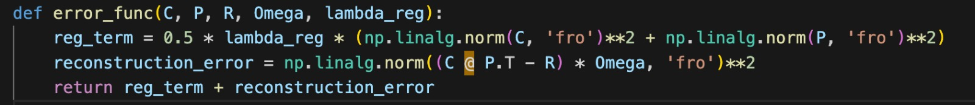
Decoding + Assessing accuracy
Block coordinate descent to get C, P
regularization error (frobenius norm, prevents overfitting)
reconstruction error (error between CP^T and R): use omega to mask out non-observed entries

Slide 17
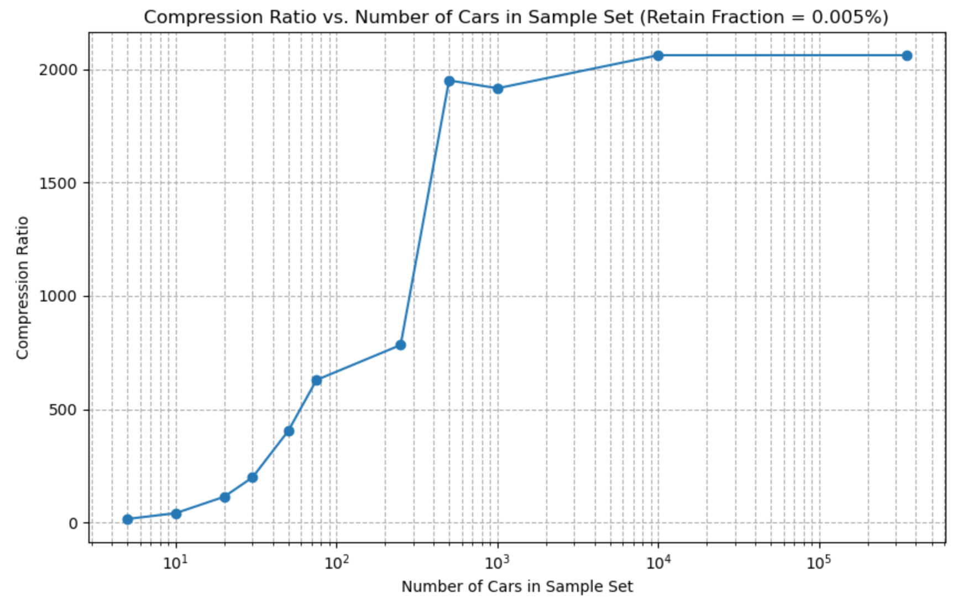
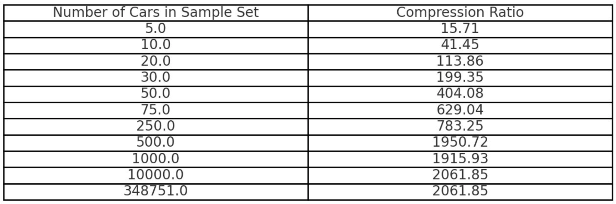
Compression results
Compression ratio table:
More data, better compression

Slide 18
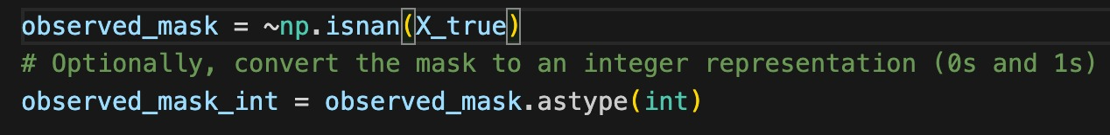
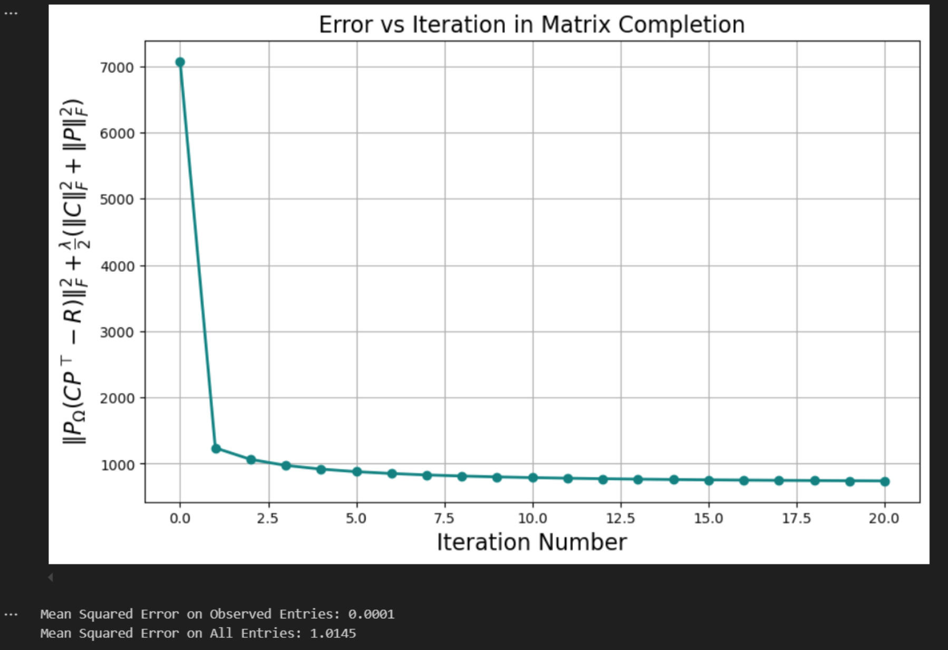
Decoding + Assessing accuracy
Assessing accuracy
(root) MSE: error between CP^T and X_true (initial data of 1000 rows)
Only compare positions where we initially had data
MSE between X_true and CP^T
Notes:
Recorded data positions with on X_true before filling with column mean

